Slide 1
Refugees to the USA
Jennifer Mead

Slide 2
Data sources
Main source:
https://www.kaggle.com/unitednations/refugee-data
Other sources:
https://www.refworld.org/cgi-bin/texis/vtx/rwmain?page=search&skip=0&query=decision+other&coi=
https://www.unhcr.org/en-us/returnees.html
https://www.dhs.gov/immigration-statistics/yearbook/2017

Slide 3
Goals
Questions to answer:
What does the pattern of refugees/asylum-seekers look like over time?
Are the patterns different for different countries, especially in the rates of approval (“recognition”) and rejection?
For the program:
Work with time series data
Work with heatmaps
Explore different ways of cleaning data
Identify further questions for analysis

Slide 4
Some context
The United Nations has laws about handling refugees/asylum seekers, enforces those rules, and collects data.
Homeland Security also collects data on immigration (including asylum seekers).
The most recent data in this analysis is 2016
“An asylum seeker …is a person who flees their home country, enters another country and applies for asylum, i.e. the right to international protection, in this other country. An asylum seeker is a type of migrant and may be a refugee, a displaced person, but not an economic migrant.” (Wikipedia)
“an asylum applicant must establish that he or she fears persecution from their Government in their home country. Second, the applicant must prove that he or she would be persecuted on account of one of five protected grounds: race, religion, nationality, political opinion, or particular social group” (Wikipedia)

Slide 5
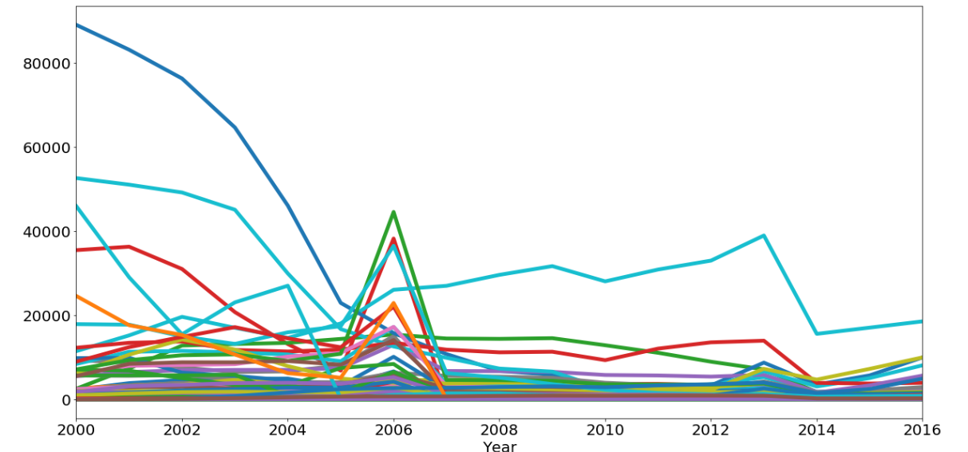
Refugees over time (2000-2016)
Spikes in 2000, 2006, 2013
Most countries are very low

Slide 6
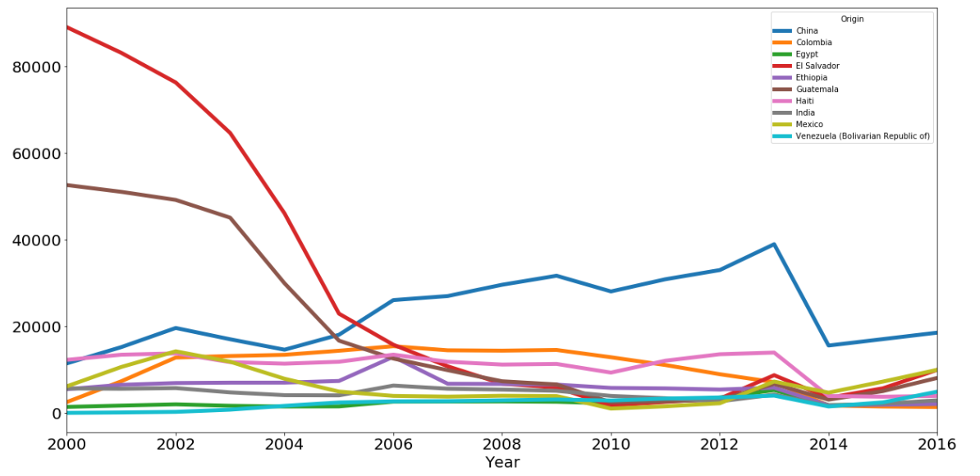
Looking at the top ten countries
Top ten: China, Colombia, Egypt, El Salvador, Ethiopia, Guatemala, Haiti, India, Mexico, Venezuela
El Salvador and Guatemala had much higher numbers in 2000

Slide 7
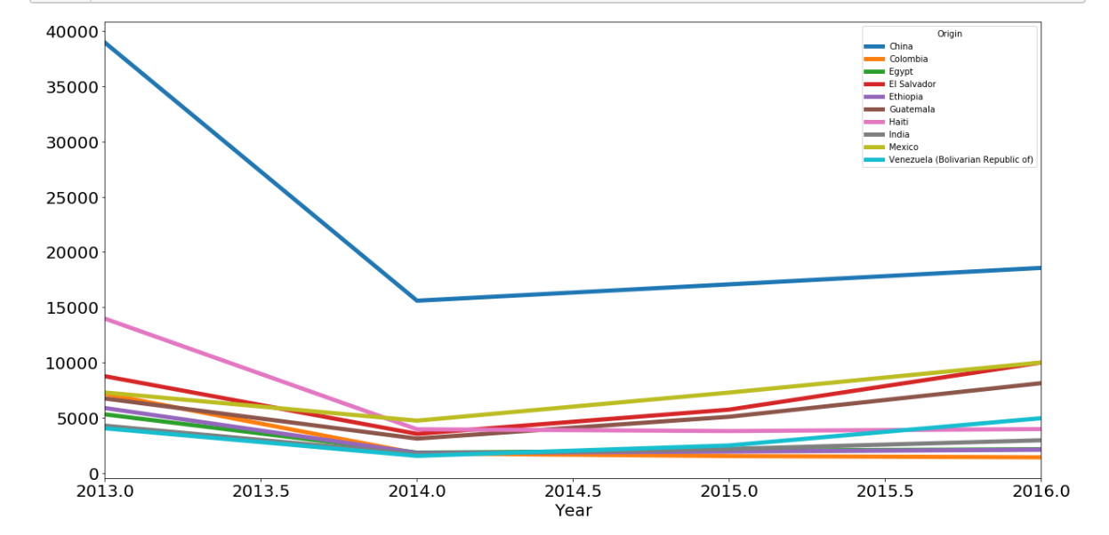
Zoom in on 2013-2016
China is the highest
Several are increasing in 2016, but not dramatically in comparison to 2013 numbers

Slide 8
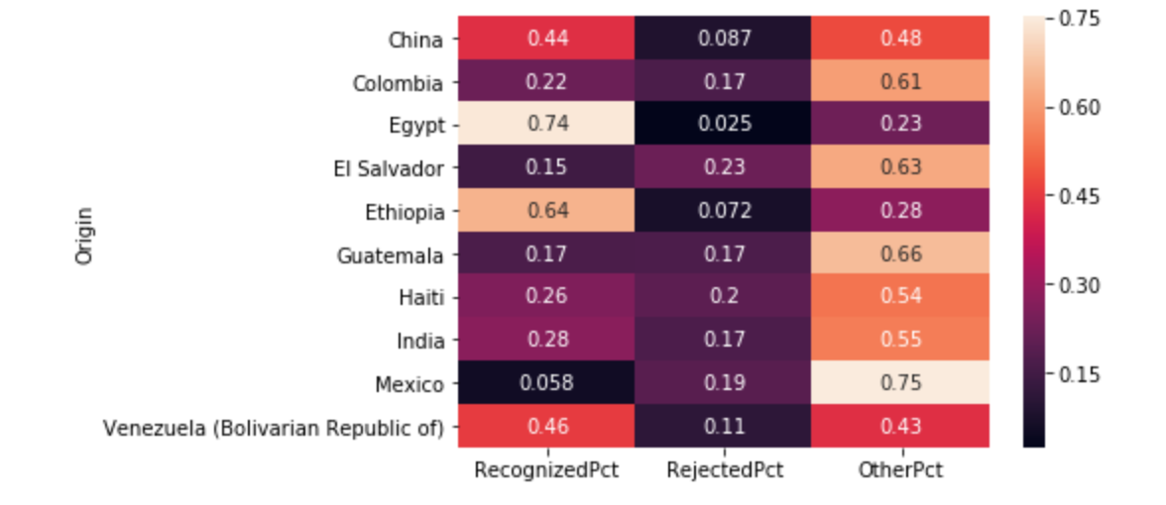
Recognized or rejected?
Most likely to be recognized:
Egypt and Ethiopia
Most likely to be “other”:
Mexico, Columbia, El Salvador, Guatemala

Slide 9
Next steps: more questions
How do I get more recent data?
Where do I get more granular data?
What does “other” mean? Why are people given an “other” decision?
What’s the definition of a “criminal” in the Homeland Security data?

